Slide 1
ANTI PESTO
A web application for Agricultural Improvement

Slide 2
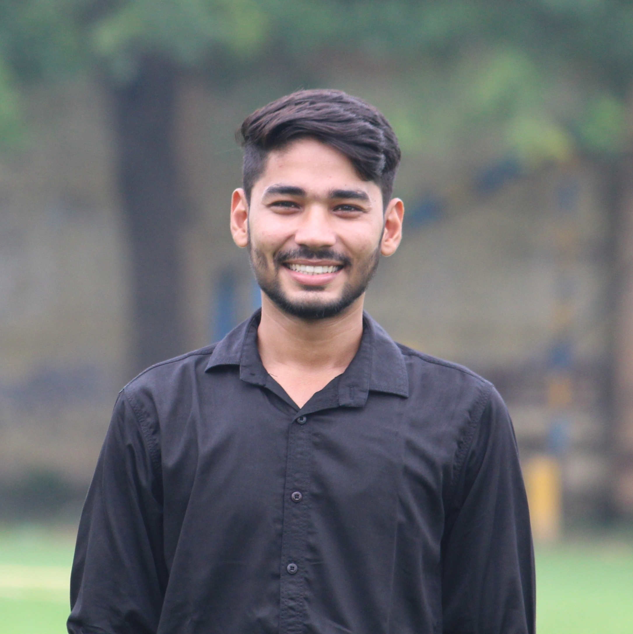
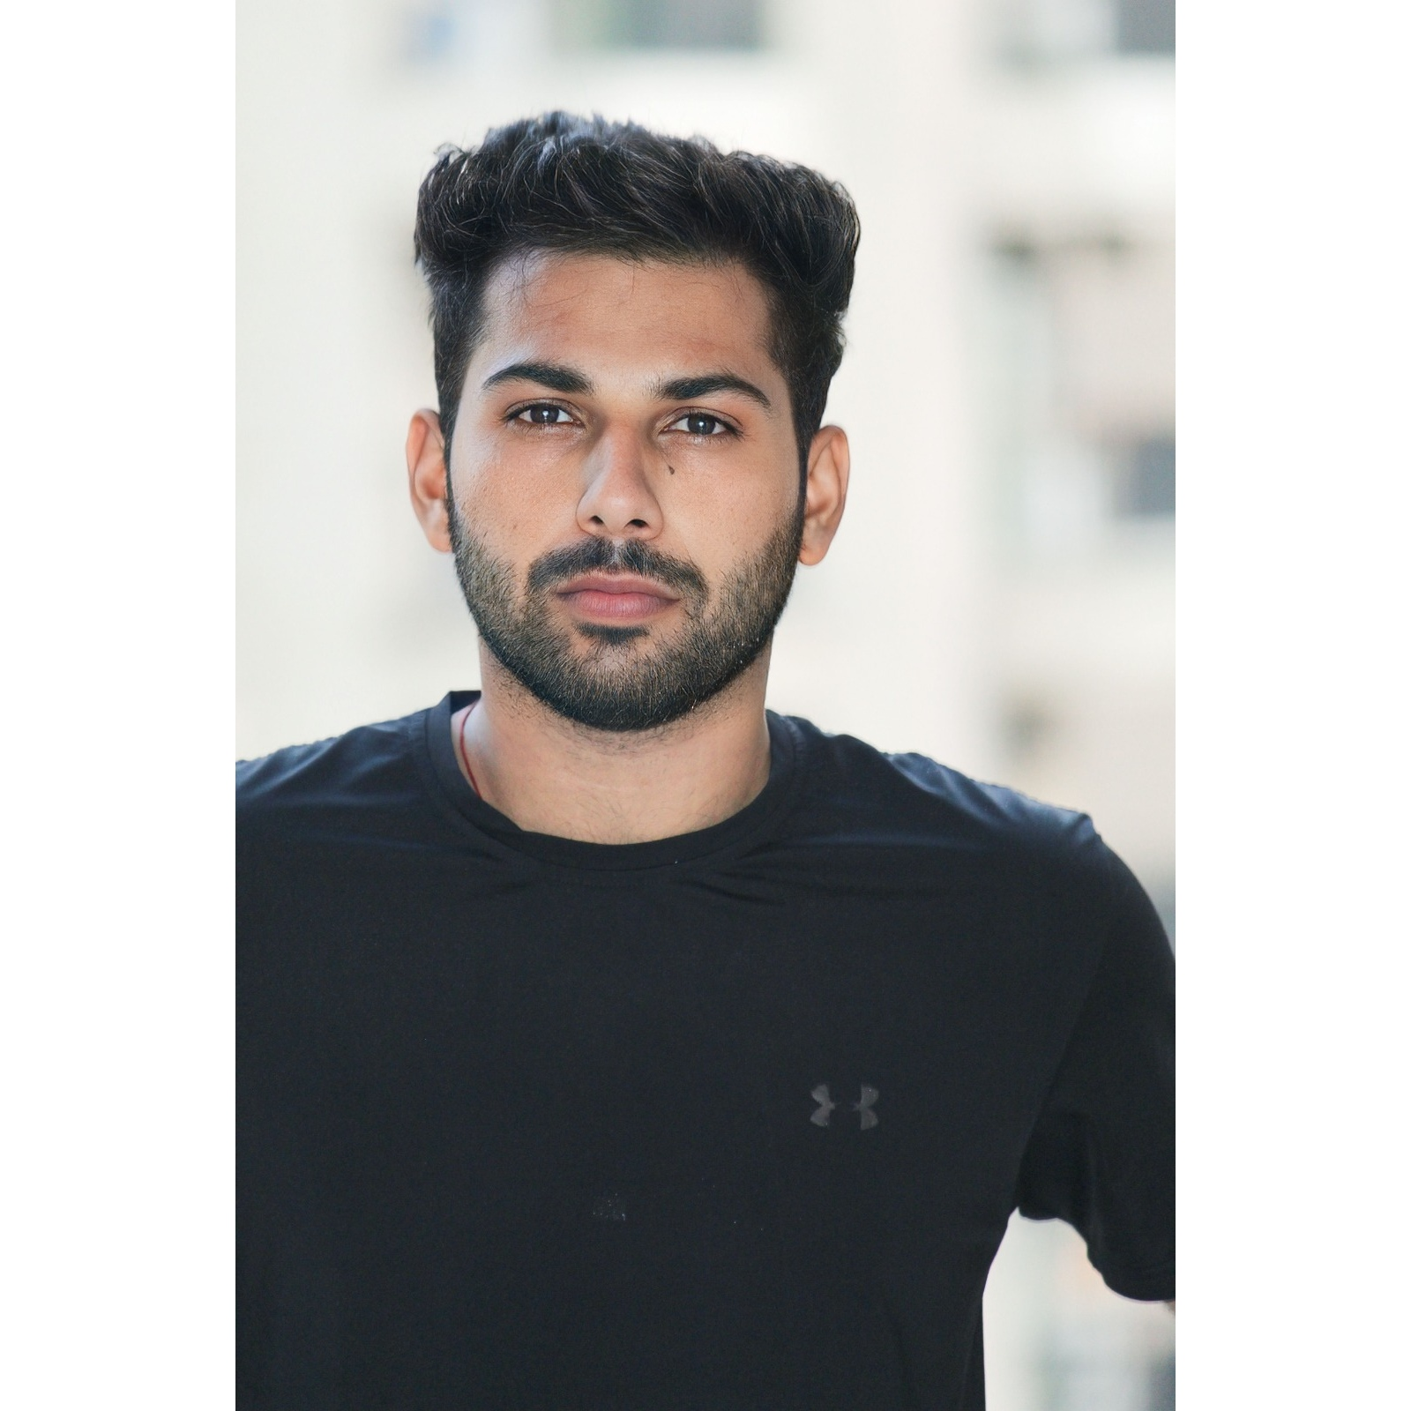
OUR TEAM
Madhav Sharma
Navneet chaudhary
2200290140083
2200290140097

Slide 3
introduction
It is a Project to help farmers.
By preventing their crops from harmful insects and pests.

Slide 4
India ranks second worldwide in farm outputs. As per the Indian economic survey 2020 -21, agriculture employed more than 50% of the Indian workforce and contributed 20.2% to the country's GDP.
“
”

Slide 5




Software requirements
My sql
bootstrap
Vs studio
xampp

Slide 6
modules
User Management Module
Admin Panel
Crop Management
Pests and Disease Management
Government Schemes
Forms and Queries

Slide 7
User Management
Users will be able to create accounts with unique usernames and passwords.
The system will Validate and authenticate the user credentials securely.

Slide 8
Admin panel
Essential details will be displayed here.
Admin will manage and change it whenever needed.

Slide 9
Crop management
Details of different varieties of Crops will be displayed in this part of the project.
Details will include like Types of Crops i.e. Rabi, Kharif etc.
Amount of watering required.
Which type of Soil is suitable.

Slide 10
Pests and disease management
Details of different harmful pests and related diseases of crops will be shown here.
Based upon the problem , suitable solutions will be mentioned.

Slide 11
Government schemes
The schemes provided by the Government for the farmers will be displayed with requirements and eligibility criteria.
Some popular schemes are :
PM Fasal Bima Yojna
PM Kisaan Samman Nidhi Yojna
Gramin Bhandaran Yojna

Slide 12
Forms and queries
Users will be given an option to submit queries.
If there is some new type of damage to the crop has occurred, it will be noticed and solution will be found.

Slide 13
AREAS OF FOCUS
Identification of pests BY Users
Prevention methods
Identification of the respective pest or insects will be done by matching the type of damage occurred in the crops with our database.
If it matches then users can get preventive methods from our web application.
Prevention methods will be mentioned for the protection of crops.
Users can choose any method according to their comfort.

Slide 14
summary
The system will feature a user-friendly front-end interface developed using HTML and CSS. This interface will allow users to easily navigate their problem of crops, making it accessible their solutions.

Slide 15
THANK YOU

